Slide 1
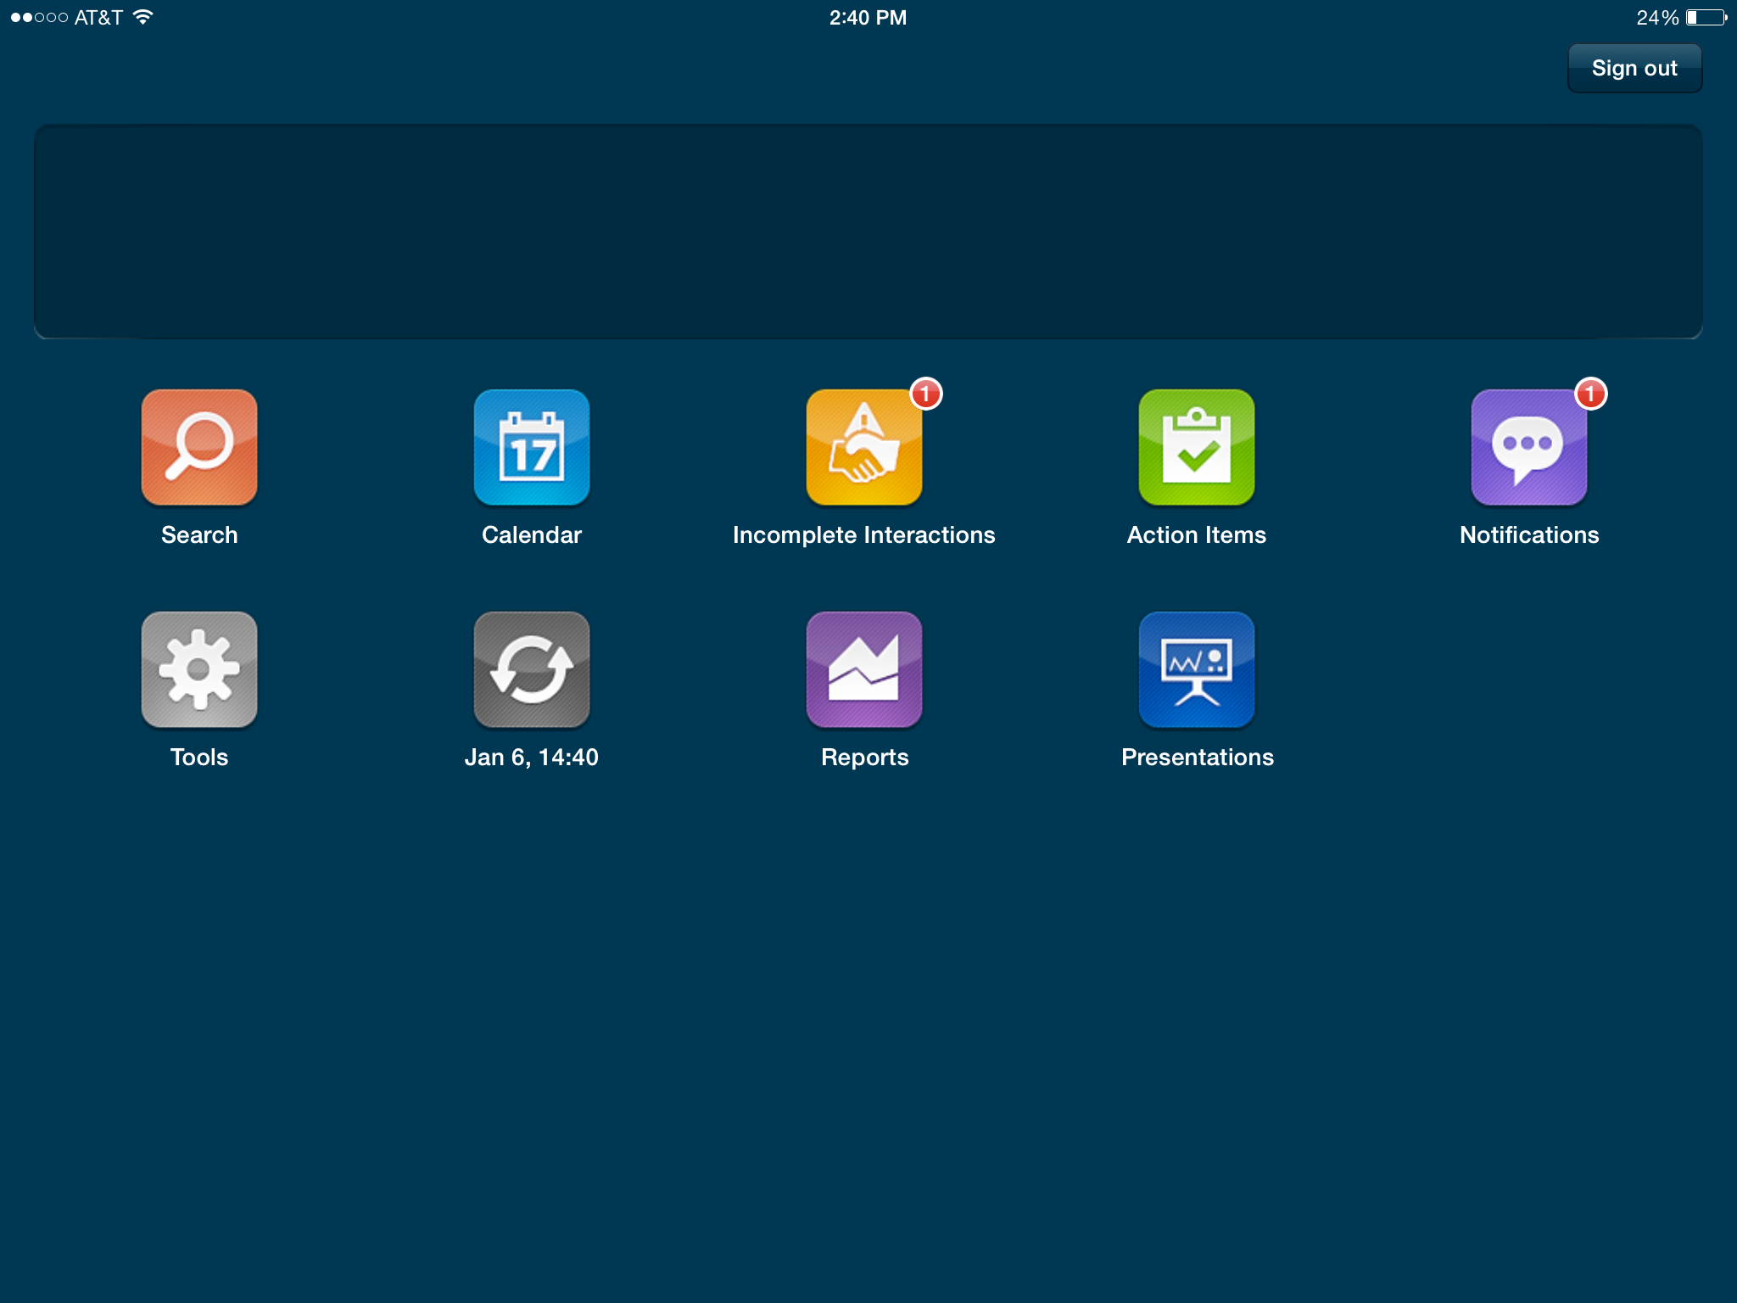
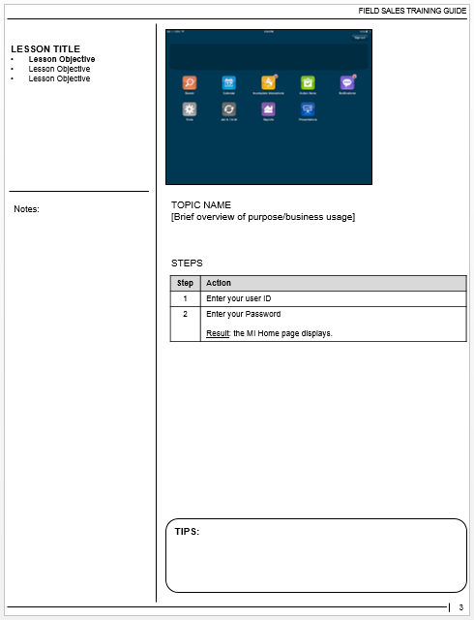
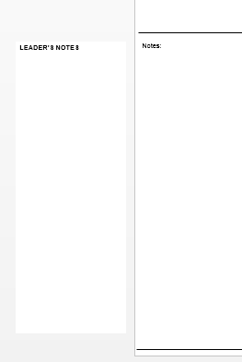
Using This Template
NORMAL “Slide” View
Slide image becomes thumbnail in guide.
If you delete this slide, you can renumber slides from 1: Design > Slide Size
If you are creating a VILT FG, replace this with a “Lobby” slide
If you delete the thumbnail, you do not delete the slide image.
The Notes Master has been used to create pre-formatted content pages. Therefore, each slide has two important views: Normal (slide) view and Notes Page view. Add feature screen shot in Normal view, add contents in Notes Page view. See sample of both views on right.
Adding Content:
Create one slide per topic. When in Normal view, use the slide to show an overview screen shot of the feature
Use the Notes Page View to add the contents for each page in the guide (i.e. topic purpose, task steps, company-specific business rules, facilitator notes). A thumbnail of the slide will automatically be included on the page
Copy a content slide to create consecutive ones
If the content spans more than one slide, create a duplicate slide, enter the overflow text and remove the slide thumbnail unless you want an additional screen shot
If using the slides as a Facilitator presentation, hide slides that are only meant to be printed as part of the guide and not displayed when presenting
Use the “Lesson Title” section to add the lesson title and objectives. Bold & underline the objective corresponding to the current slide
Adding Leader’s Notes:
For slides that need facilitator notes, use the leader’s notes text box on the outside left of the slide
Printing Participant or Leader Guide:
To print the guide, print the Notes Pages. Note: Top/bottom margins are minimized when printing directly from PPT instead of PDF
By default, hidden slides print, but do not display when presenting. If you do not want to print hidden slides as part of the guide:
File > Print > Settings > Click “Print All Slides” > Uncheck “Print Hidden Slides”
When printing the Leader’s guide version, be sure to drag the “Leader’s Notes” text box over the blank “Notes” box on each slide before printing
NOTES PAGE View
Notes:
US CUSTOMER TRAINING
Training Guide Template
REFER TO SLIDE CONTENTS FOR DIRECTIONS ON HOW TO USE THIS TEMPLATE
IF YOU ARE CREATING A VILT FG:
You can convert this instruction slide to a lobby slide:
Drag and drop the trainer instructions over the Notes Page content
Switch to the Normal view and create a “Lobby” slide which includes i.e. activities for attendees to complete prior to the session
Action: (P) = Producer

Slide 2
OCE Administration
Training Guide
March 2018
Notes:
Exercise Book
OCE CRM Administration Training
With Leader’s Notes
Dev Notes:
❷ When printing a Leader’s version, drag and drop this box under “Participant Guide”
Dev Notes:
❶ Add the Customer Logo here (or at top left, if more visually appealing

Slide 3
Classroom Exercises
Notes:
CLASSROOM EXERCISES
Instructions
You are now the Admin of OCE.
Your trainer will provide a URL and credentials to access an OCE Org.
Perform the activities one by one, as instructed by your trainer.
When you see this symbol “*”, replace it with your initials.

Slide 4
Switch to Notes Page view to add exercises
Duplicate this slide to add more pages
USERS & PROFILES
Notes:
EXERCISE #1: OCE USER
You have been appointed to be the OCE Administrator.
Using the System Admin login details provided to you, create an OCE User for yourself with the appropriate permissions and Profile.
Steps:
Create a user for yourself based on the instructions below:
Use your name / professional email for the details
User License = Salesforce
Profile = OCE Admin
Enable Quick Access Menu
Be creative for the Phone & Address
Save
Assign the following Permission Sets
Admin Console All
FieldCoaching_Administration
Meeting Admin
OneKey Connector User
Order Management User
Order Management Admin
Samples Management Admin
Samples Management User
An email will be sent to you. Click VERIFY account.
Define your own password and security question. Password:_________________ Security Question: __________________________
→ LOG IN WITH YOUR OCE ADMIN USER AND PERFORM ALL OTHER EXERCISES WITH THIS USER.
BEFORE STARTING:
DEACTIVATE the following users:
OCE ADMIN
SALES REPRESENTATIVE
(ONLY If an OCE Admin and Sales Representative User are already ACTIVE in the system)
Dev Notes:
❶ Delete slide thumbnail
❷ Type exercise scenario & steps
Note: You can add more than one exercise to a page
USERS & PROFILES

Slide 5
Switch to Notes Page view to add exercises
Duplicate this slide to add more pages
USERS & PROFILES
Notes:
EXERCISE #2: NEW PROFILE
Some settings should be available only some Sales Representative users of OCE App. Therefore, a new Profile should be created for them.
Steps:
From the Admin Console > Mobile > Profiles > Clone the existing Sales Representative profile and name it SalesRep*.
Include the new profile in OCE Schema Setting.
From the Admin Console > Mobile > Profiles
Click Apply to Configuration next to your SalesRep* profile
Use Source Profile = Sales Representative
Click Preview, and then Copy
LEADER’S NOTES
Dev Notes:
❶ Delete slide thumbnail
❷ Type exercise scenario & steps
Note: You can add more than one exercise to a page
USERS & PROFILES

Slide 6
Switch to Notes Page view to add exercises
Duplicate this slide to add more pages
USERS & PROFILES
Notes:
EXERCISE #3: SALES REP USER
A new Sales Representative will join the Company and work with OCE Mobile App.
Provide her access to OCE with the appropriate permissions and Profile.
Steps:
Create a new user based on the instructions below:
First name & Last Name: Cara BLACK*
User name: cblack*@iqvia.com
Email Address: Your professional email
User License = Salesforce Platform
Profile = SalesRep*
Be creative for the Phone & Address
Save
Assign Permission Sets:
FieldCoaching_SalesRep
Meeting User
OneKey Connector User
Order Management User
Samples Management User
An email will be sent to you. Click VERIFY account
Define the following password:
Password = Training1
Security Question = In which city were you born?
Answer = Paris
LEADER’S NOTES
Dev Notes:
❶ Delete slide thumbnail
❷ Type exercise scenario & steps
Note: You can add more than one exercise to a page
USERS & PROFILES

Slide 7
Switch to Notes Page view to add exercises
Duplicate this slide to add more pages
TERRITORIES
Notes:
EXERCISE #1: TERRITORY CREATION
Cara BLACK* will work on a territory covering Berlin city.
Another Sales Representative territory will be created to cover Berlin.
Both territories will report to a DM territory.
Steps:
Create the following Territories:
Account Access = Users in these territories must be able to view and edit accounts assigned to these territories.
EXERCISE #2: ACCOUNT ALIGNMENT
On the TER-REP1-ONCO* territory, Cara BLACK* will visit Dr. Agustin Liotta and Accounts on Berlin ZIP Codes 10115 and 12203.
Steps:
Define a Customer Alignment Rule to align Dr. Agustin Liotta to TER-REP1-ONCO*.
From the App Launcher, define 2 Territory Alignment Rules to assign 10115 and 12203 ZIP Codes to TER-REP1-ONCO*.
From the TER-REP1-ONCO* territory, define an Account Assignment Rule. This rule is based on the field: “Account: Account Record Type” and should retrieve:
Practices
Institutions
Pharmacies
Departments
MPs (Medical Professionals)
BCs (Business Contacts)
Make sure that the Rule is “Set as Active”.
From the Admin Console, run the Zip to Territory job. Then, run the Account Assignment Rule the TER-REP1-ONCO* territory.
LEADER’S NOTES
Dev Notes:
❶ Delete slide thumbnail
❷ Type exercise scenario & steps
Note: You can add more than one exercise to a page
TERRITORIES

Slide 8
Switch to Notes Page view to add exercises
Duplicate this slide to add more pages
PRODUCTS
Notes:
EXERCISE #1: PRODUCTS
The TER-DM-ONCO* territory, and its sub territories will promote the following products. All these products belong the ONCOLOGY* Market.
Steps:
Create your products with:
Appropriate product type and details
Appropriate Parent-child relationships
Start & end dates
Product Messages for Detail products
Lot Number and lot allocation for Samples
Align the products and messages to the TER-DM-ONCO* territory and its sub territories. Do not forget to align the Product Messages!
The TER-REP2-ONCO* territory should not have access to LESSPAIN* 30ml.
LEADER’S NOTES
Dev Notes:
❶ Delete slide thumbnail
❷ Type exercise scenario & steps
Note: You can add more than one exercise to a page
PRODUCTS

Slide 9
Switch to Notes Page view to add exercises
Duplicate this slide to add more pages
CLM
Notes:
EXERCISE #1: CLM ADMINISTRATION
Create the LESSPAIN Presentation*, for the TER-DM-ONCO* territories and sub-territories.
Steps:
From the Admin Console, load the sequences provided to you.
The sequences are used to build a presentation called LESSPAIN Presentation*.
Define Start and End dates for the Presentation
Fine-tune the Sequences
Some sequences should be mandatory
Link products and messages to the sequences
Fine-tune LESSPAIN Presentation*.
Re-order sequences
Define Player Gestures
Distribute the Presentation to the TER-DM-ONCO* Territory and sub-territories.
Activate LESSPAIN Presentation*.
Dev Notes:
❶ Delete slide thumbnail
❷ Type exercise scenario & steps
Note: You can add more than one exercise to a page
CLM

Slide 10
Switch to Notes Page view to add exercises
Duplicate this slide to add more pages
FIELD COACHING
Notes:
EXERCISE #1: COACHING FORM TEMPLATE CREATION
Steps:
From OCE application, go to the Coaching Form Templates tab.
Create the Evaluation Review* Coaching Form Template that will be available for use in October.
EXERCISE #2: QUESTIONS CREATION
Steps:
From OCE application, go to the Questions tab and create the following questions:
Link your questions to the Evaluation Review* form (from the Related tab of the coaching form).
Some questions should be mandatory.
EXERCISE #3: COACHING FORM TEMPLATE SHARING
Steps:
Share the Evaluation Review* Coaching Form Template.
Share the form with TER-DM-ONCO* territory.
With Read-only permissions.
The Scale uses JSON format.
Ex of Scale:
[
{
"label": "No",
"score": 5,
"description": "Negative answer",
"weight": 0.5
},
{
"label": "Yes",
"score": 10,
"description": "Positive answer",
"weight": 1.0
}
]
Dev Notes:
❶ Delete slide thumbnail
❷ Type exercise scenario & steps
Note: You can add more than one exercise to a page
FIELD COACHING TEMPLATE

Slide 11
Switch to Notes Page view to add exercises
Duplicate this slide to add more pages
RATINGS
Notes:
EXERCISE #1: RATING CONFIGURATION
Configure the ratings that should be displayed on the HCP profile, for users belonging to the SalesRep* Profile.
Steps:
Configure the SalesRep Ratings* Layout with the ratings below:
Create fields in the appropriate Object, if necessary
Define color ranges when applicable.
Save and deploy the SalesRep Ratings* Layout.
Note: Ratings component will be added to the HCP Profile page later.
Dev Notes:
❶ Delete slide thumbnail
❷ Type exercise scenario & steps
Note: You can add more than one exercise to a page
RATINGS

Slide 12
ADA LITE
Notes:
11
EXERCISE #1: ADA LITE ACTIVATION
Perform all the following steps to activate ADA from the Admin Console.
Remember it is important to do all this manipulation with your OCE ADMIN user.
Steps:
Start provisioning AdaLite External Instance from Admin Console > AdaLite Provisioning
From Setup > Profile, grant the OCE Admin Profile access to the NBC Admin (auto-created)
From Setup > Manage Connected Apps, control that the "Permitted Users" dropdown is set to to "Admin approved users are pre-authorized“ in the OAuth policies section.
From the Admin Console > ADA Lite tile run the first Sync (it could be long).
EXERCISE #2: SET METRICS
Configure metrics to be used for the NBC score calculation, for the TER-DM-ONCO** and child territories.
Steps:
Configure metrics to be used for the NBC score calculation, TER-DM-ONCO* and sub territories.
Define values and weight for the following metrics:
Recently Called
Is Target
Call Planned
Save and deploy these metrics.
Check the results in the Preview section.
Sync the Results to Salesforce.
WARNING!
Exercise #1 should only be done once, with the OCE Admin user, and before any other user accesses the ADALite module.
If you can access the AdaLite module and view metrics, then the External Instance has arleady been provisioned and you do not need to perform Exercise #1.
Dev Notes:
❶ Delete slide thumbnail
❷ Type exercise scenario & steps
Note: You can add more than one exercise to a page
ADA LITE CONFIGURATION

Slide 13
Switch to Notes Page view to add exercises
Duplicate this slide to add more pages
HOME PAGE
Notes:
EXERCISE #1: HOME PAGE CONFIGURATION
Configure the Home page for the SalesRep* profile, as described below:
Steps:
In Lightning App Builder, clone the Home Page Default page and rename fields as follow:
Label: Home Page Sales Rep*
Developer name: Home_Page_Sales_Rep*
Configure the new home page with the following indications:
The following Components must be displayed
AppInstall,
NBCTopResults,
NBCLeaderboard,
UpComingAgenda
UnsubmittedCalls,
TerritoryCallPlan
Add the Reports Component in order to display the Call per Month by Channel Report. The users must be able to refresh the report.
Place the TerritoryCallPlan Component under the report.
Save the Home Page and activate it for the SalesRep* Profile.
Generate a Metadata Cache to reflect changes in the Mobile App.
LEADER’S NOTES
Dev Notes:
❶ Delete slide thumbnail
❷ Type exercise scenario & steps
Note: You can add more than one exercise to a page
HOME PAGE

Slide 14
Switch to Notes Page view to add exercises
Duplicate this slide to add more pages
SEARCH & STATIC LISTS
Notes:
EXERCISE #1: ACCOUNT TYPES CONFIGURATION
Configure the types of Account that can be used for filtering.
Steps:
From Custom Settings > Account Search Type Settings, manage a new setting called SalesRep*:
Settings should apply for the SalesRep* Profile
All Account types should be available as filters
Enable Bulk Update
EXERCISE #2: ALL ACCOUNTS COLUMN SETUP
Define the Columns that will be displayed when viewing “All” Accounts in the search page.
Steps:
From Custom Settings > Account Filter Config manage a new seting called SalesRep*_ALL_ACCOUNTS:
Column 1= Account Name
Column 2 = Specialty (from Account Object)
Column 3 = Scheduled Calls (from Account Territory Field Object)
Column 4 = POA
Column 5 = Email (From Account Object)
Settings should apply for the SalesRep* Profile
Settings should apply to the “ALL” Accounts view
EXERCISE #3: FILTERS SETUP
Activate the Filters feature.
Steps:
From the OCE Admin Profile > Edit the Custom Permissions section and add the OCE CRM.COE.DynamiLIsts permission, to enable the Dynamic Lists tile in the Admin Console.
From Admin Console > Dynamic Lists tile, check that the feature is activated for the SalesRep* Profile.
Create a Metadata cache to apply the changes.
LEADER’S NOTES
Dev Notes:
❶ Delete slide thumbnail
❷ Type exercise scenario & steps
Note: You can add more than one exercise to a page
SEARCH & STATIC LISTS
Remember:
For fields from the Account Object, just type the field name.
Fields NOT coming from the Account Object must be prefixed with the Reference Table name:
Ref Table name.Field Name
Ref Table Name is based on Object API Name:
Object=
Account Address
API: OCE__AccountAddress__c
Ref Table: OCE__AccountAddress__r
API Names are shown in Object Manager.
Field Names are shown in Object > Fields & Relationships

Slide 15
Switch to Notes Page view to add exercises
Duplicate this slide to add more pages
ACCOUNT PROFILE
Notes:
EXERCISE #1: HCP PROFILE – TAB CONFIGURATION
For all the Sales Representatives belonging to the SalesRep* Profile, configure the profile pages of HCP Accounts..
Steps:
In Lightning App Builder, clone the HCP Profile page and rename fields as follow:
Label: HCP Profile*
Developer name: HCP_Profile*
Modify Tabs as described below:
Display the SCORE tab in 2nd position
Rename the CHARTS tab to GRAPHS
Add the RATINGS tab and place it in 5th position
EXERCISE #2: HCP PROFILE – DASHBOARD TAB
For all Sales Representatives belonging to the SalesRep* Profile, configure the DASHBOARD tab of HCP Accounts.
Steps:
In the Dashboard tab of the HCP Profile*, configure the SALES CHARTS:
Users should view Xponent Sales Data in both Chart and Table view
Display Sales data using a weekly scale
Create a new Field set in the Account object called CustomerInfo-HCP*.
Add the OnkeyId, Specialty, Email and Birthday fields
Create a new Field set in the Account Address object called CustomerInfo-HCP*.
Add the Preferred Address and Sampling (formula) fields.
In the Dashboard tab of the HCP Profile*, configure the Customer Info component using the CustomerInfo-HCP* Field sets from the Account and Account Address objects.
RECOMMENDATION:
Open 2 tabs:
One tab to configure the Lightning page of the HCP Profile*
One tab to modify data and content of the components of the HCP Profile*.
EXERCISE #2:
REMEMBER:
You must switch to Sales Force Classic view to access Field sets.
Create new field sets for the Customer Info Component rather than modify the existing “Customer Info Dashboard“ field set, as the modifications should impact HCP Profile pages, for users belonging to the Sales Representative profile only.
Dev Notes:
❶ Delete slide thumbnail
❷ Type exercise scenario & steps
Note: You can add more than one exercise to a page
ACCOUNT PROFILE

Slide 16
Switch to Notes Page view to add exercises
Duplicate this slide to add more pages
ACCOUNT PROFILE
Notes:
EXERCISE #3: HCP PROFILE – GRAPHS TAB
For all the Sales Representatives belonging to the SalesRep* Profile, configure the GRAPHS tab of HCP Accounts.
Steps:
In the GRAPHS tab of the HCP Profile*, add another Report Component :
Display the Calls per Month by Channel report
Place it above the Calls by Month report
Enable users to refresh the both reports
Add the AccountCallPlan Component below the charts.
EXERCISE #4: HCP PROFILE – RATINGS TAB
Define the Ratings that should be available for on the HCP profile page.
Steps:
In the RATINGS tab of the HCP Profile*, add Ratings Component.
Select the SalesRep Ratings* Layout that you previously created.
EXERCISE #5: HCP PROFILE – ACTIVITY TAB
For all Sales Representatives belonging to the SalesRep* Profile, configure the ACTIVITY tab of HCP Accounts.
The Show filter should be set on “Mine” by default
The Address filter should be disabled
Steps:
From the Admin Console > Activity History Administration:
Define the territory and address settings for the SalesRep* Profile
EXERCISE #6: HCP PROFILE – ACTIVATION
Steps:
Save the HCP Profile* Lightning page configuration and activate it at App, Record Type and Profile level.
OCE App
BC and MP Record Types
SalesRep* Profile
Dev Notes:
❶ Delete slide thumbnail
❷ Type exercise scenario & steps
Note: You can add more than one exercise to a page
ACCOUNT PROFILE

Slide 17
Switch to Notes Page view to add exercises
Duplicate this slide to add more pages
ACCOUNT TERRITORY FIELDS (ATF)
Notes:
EXERCISE #1: ATF CONFIGURATION
For all the Sales Representatives belonging to the SalesRep* Profile, configure Account Territory Fields as described below.
Steps:
From the Account Territory Field Object, create a copy of the existing Account Territory Field Layout:
Layout name = Account Territory Field Rep* Layout
Add the Available Offline and Scheduled Calls fields
Assign the Layout to SalesRep* Profile and HCP Record Type.
In the Lightning page of the HCP Profile*, check that the Account Territory Fields component has been added in the Dashboard tab.
Place the ATF component between the Customer Info component and the Sales Chart component.
Save the configuration.
Dev Notes:
❶ Delete slide thumbnail
❷ Type exercise scenario & steps
Note: You can add more than one exercise to a page
ACCOUNT TERRITORY FIELDS (ATF)

Slide 18
Switch to Notes Page view to add exercises
Duplicate this slide to add more pages
PLANNER
Notes:
EXERCISE #1: PLANNER CONFIGURATION
For all the users belonging to the SalesRep* profile, configure the planner based on the instructions below:
Steps:
Define new Planner settings for the SalesRep* profile:
Define new colors for the Completed & Planned Calls, General Events, and Time off Territory.
Start day and time should be Monday, at 08:00
The time format should be military time format.
Call Confirmation and Routes must be enabled
Create a metadata cache to apply all your Planner settings.
REMEMBER
Hex codes are used to define colors of events in the Planner.
See examples:
http://www.color-hex.com
Dev Notes:
❶ Delete slide thumbnail
❷ Type exercise scenario & steps
Note: You can add more than one exercise to a page
PLANNER

Slide 19
Switch to Notes Page view to add exercises
Duplicate this slide to add more pages
CALL
Notes:
EXERCISE #1: CALL CONFIGURATION
For all the users belonging to the SalesRep* profile, configure the CALL HEADER and EXPENSES SECTION based on the instructions below:
Steps:
Copy the existing Call Layout and rename it Call Layout Sales Reps*:
Move the Is Confirmed field below the Date & Time field
Assign the Call Layout Sales Reps* layout to the SalesRep* profile
From the Call Expense Object, manage the Type pick list values for all users of the company:
Add the Bus value
Reorder the values
EXERCISE #2: CALL ADMINISTRATION
For the users belonging to the SalesRep* profile, configure the following CALL RULES:
Steps:
From the Admin Console, define the following Call Administration settings :
Users from the SalesRep* Profile should be able to plan a call up to 15 days in the future, and submit a call 5 days maximum after the Call date.
Product Details should be mandatory to submit a call but not Samples
Dev Notes:
❶ Delete slide thumbnail
❷ Type exercise scenario & steps
Note: You can add more than one exercise to a page
CALL

Slide 20
Switch to Notes Page view to add exercises
Duplicate this slide to add more pages
CALL
Notes:
EXERCISE #3: SIGNATURE LOGO
Change the Call signature Logo for all users of the Company.:
Steps:
Go to the Logo_Image_1 Static Resource and change the logo.
Upload an IQVIA logo
EXERCISE #4: CALL SIGNATURE DISLCAIMER
All the users of the company should have the same disclaimer text in the Call Signature page.
Steps:
Override the English translation for the Default Disclaimer_Text OR Create a new Custom Label called Disclaimer_Text_* :
Link it to the appropriate category
Be creative for the value (Text) of the Disclaimer
Create a Metadata cache
For Admin Console > Call Administration, select the Custom Label to be used for the SalesReps* (Disclaimer_Text or .Disclaimer_Text_*).
Create a metadata cache to apply all your Call configurations and settings.
Dev Notes:
❶ Delete slide thumbnail
❷ Type exercise scenario & steps
Note: You can add more than one exercise to a page
CALL

Slide 21
Switch to Notes Page view to add exercises
Duplicate this slide to add more pages
MIRF
Notes:
EXERCISE #1: MIRF CONFIGURATION
The Medical Inquiry Request Form (MIRF) for SalesRep* profile should be configured as follows..
Steps:
Create a copy of the MIRF Sales Representative Layout and call it MIRF SalesRep* Layout.
Add the Submitted Date Time field
Place the Fields section (with Special Handling Instructions) on top of the Response section.
Assign this MIRF SalesRep* Layout to the SalesRep Profile and all Record Types
Override the English translation for the default Disclaimer_Text_for_MIRF OR Configure the a new Custom Label called Disclaimer_Text_for_MIRF_* :
Link it to the appropriate category
Be creative for the value (Text) of the Disclaimer
Create a Metadata cache
For Admin Console > MIRF Administration, select the disclaimer to be used for the SalesRep* profile (Disclaimer_ Text or Disclaimer_ Text_for_MIRF_*.).
Create a metadata cache to apply all your MIRF configurations and settings.
Dev Notes:
❶ Delete slide thumbnail
❷ Type exercise scenario & steps
Note: You can add more than one exercise to a page
MIRF

Slide 22
TRANSLATIONS
Notes:
TRANSLATION
EXERCISE #1: TRANSLATION RULES
What Translation options are available in Salesforce?
Is it possible to get translations of Standard Objects?
EXERCISE #2: TRANSLATING CUSTOM COMPONENTS
Steps:
Override the translations of following items, for the OCE CRM package and French Language:
The Field Label of the ‘NBC’ Action must be renamed ‘PMC’.
The Field Label of the ‘Meilleur Client Suivant’ Action (NextBestCustomer), must be renamed ‘Prochain Meilleur Client’.
Save your changes.
Create a metadata cache to apply all your Translation Changes to the Mobile and Web Apps.

Slide 23
DASHBOARDS AND REPORTS
Notes:
DASHBOARD & REPORT
EXERCISE #1: DEFINE A REPORT CHART ON HOME PAGE.
Create a Report that will show the number of Calls made by month.
Steps:
Select Reports from the App Launcher.
Create a New Report (in SalesforceClassic) based on “Calls with Accounts”.
Show All Calls
Add the Call Type and Date &Time Fields
Sort by Account Names by Ascending Order
Group by Date & Time
Choose a Summary Format
Save the Report
Name the report Call Report*
Place it in the OCE Reports Folder
Run the Report
Add a Chart view to the report
Slect a Donut chart format
The Home Page Sales Rep* Lightning page you created earlier, add a Report component and display your Call Report*.
Save the changes and generate a Metadata Cache to apply the changes in the Mobile app.

